Slide 1
20190408
Machine Learning를 이용한 1D DBR 설계
Deep Q Network (DQN)
Lee Jong Geon

Slide 2
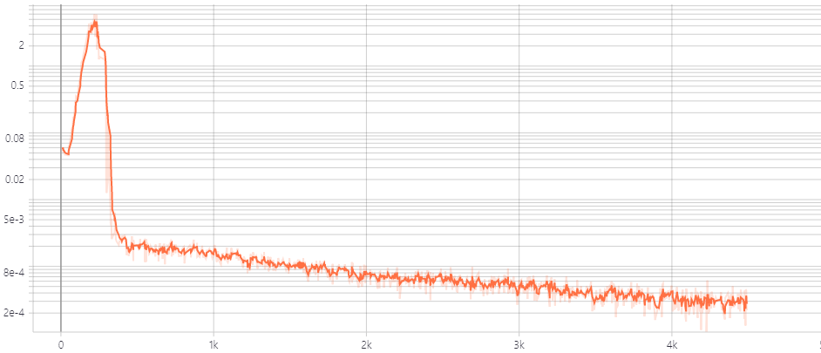


Deep Q Network (DQN) – minimize loss
$$L_{i}\left(θ_{i}\right)=Ε\left[{\left(r+γ\max{\hat{Q}\left(s^{′},a^{′};{\hat{θ}}_{i}\right)}−Q\left(s,a;θ_{i}\right)\right)}^{2}\right]$$
Loss
Target
Learn
Learning Rate ($γ$) = 1E-5
48h
Loss
Learning Step

Slide 3
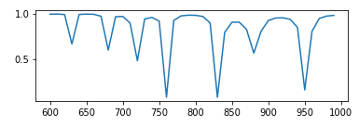


Deep Q Network (DQN) - Reward
Side Level
Side Level
Q: Q-factor
SLA: Side Level Average
A: Constants
Before
After
$$A∙\frac{Q}{\left(SLA\right)}$$
$$A∙Q^{\frac{1}{3}}∙(1−SLA)$$

Slide 4
Artificial Intelligence
Machine Learning
Supervised
Learning
Unsupervised Learning
Reinforcement
Learning
Classification
Clustering, recommendation
Reward maximization

Slide 5



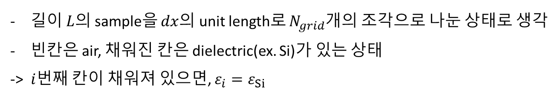
1D DBR model
$$L=N_{grid}∗dx$$
$$dx$$
$$i$$
…
길이 $L$의 sample을 $dx$의 unit length로 $N_{grid}$개의 조각으로 나눈 상태로 생각
빈칸은 air, 채워진 칸은 dielectric(ex. Si)가 있는 상태
-> $i$번째 칸이 채워져 있으면, $ε_{i}=ε_{Si}$

Slide 6
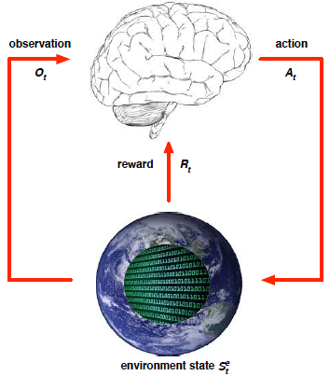
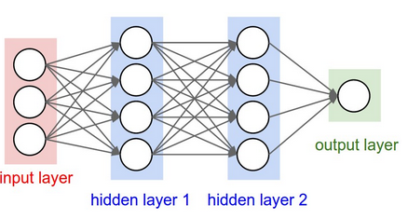
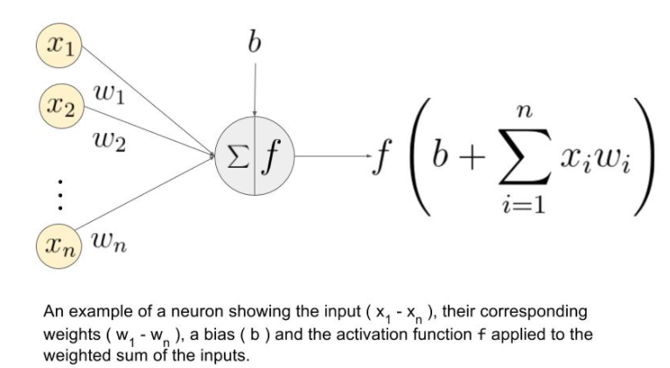
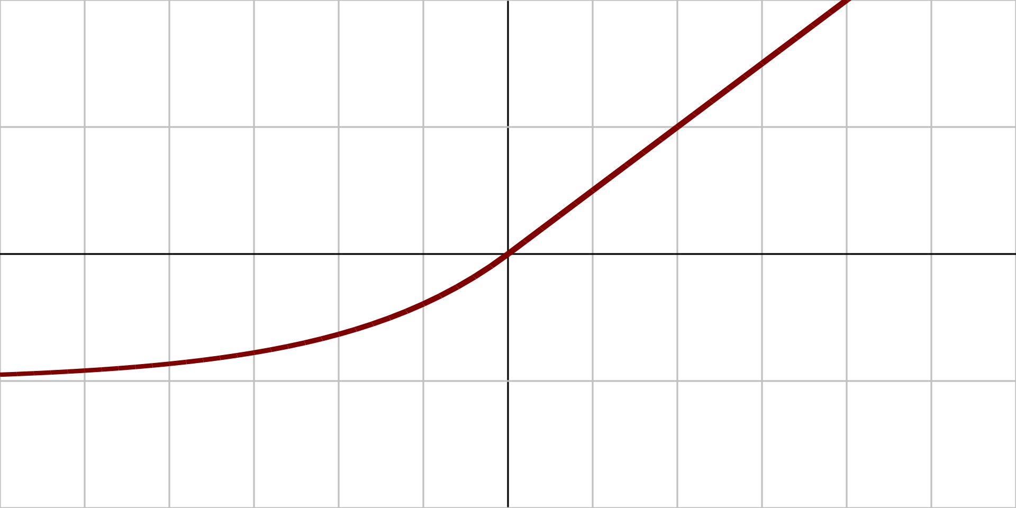


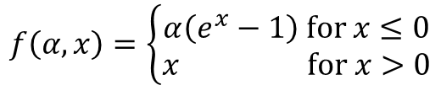



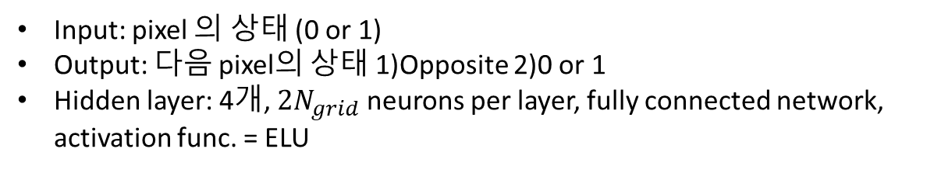
Deep Q Network (DQN)
Q(s,a)
$$N_{grid}$$
$$N_{grid}$$
$$N_{grid}$$
1) $N_{grid}$
2) ${2N}_{grid}$
$$f\left(α,x\right)=\left\{\begin{aligned}α\left(e^{x}−1\right) for x≤0 \\ x for x>0\end{aligned}\right.$$
Input: pixel 의 상태 (0 or 1)
Output: 다음 pixel의 상태 1)Opposite 2)0 or 1
Hidden layer: 4개, ${2N}_{grid}$ neurons per layer, fully connected network, activation func. = ELU

